Slide 1
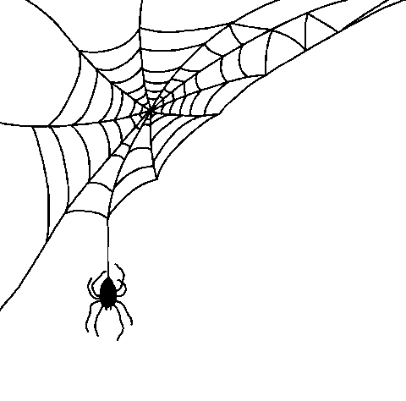
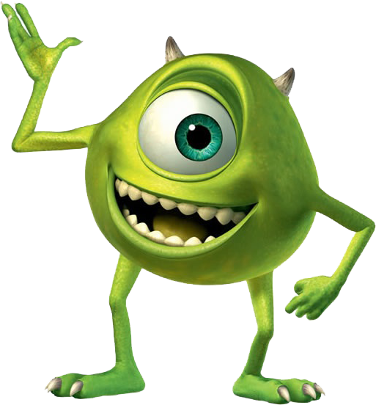
How to get scary on Halloween
in 6 easy steps

Slide 2


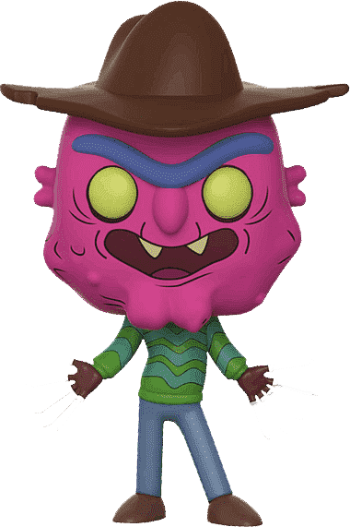
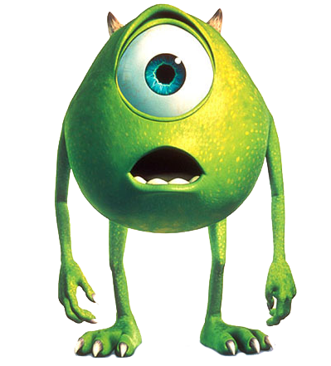
Step 1. Admit you need something and ask for it!
I need a hat!!
I need a hat,
to be that scary!
His real name is Chrome, and he has a particular way of sending and getting informations, known as HTTP. That way he is able to break data into smaller pieces, to make it easier to transport.
Hey, Buddy! Please help me find www.scary-hats.com

Slide 3

Step 2. Let your buddy do the job for you. He knows how to get things...!
Hi, bro! I need you to help me find http://www.scary-hats.com.
DNS is like a translator, that takes the domain name and translate it into an IP code, that servers use to communicate.
DNS
Anything for you, my brother! Take this IP address: http://79.119.104.176. It should help you get entrance to the Big Boss!

Slide 4


Step 3. Once Buddy has the IP address, he goes to the miracle maker!
DNS
WEB SERVERS
Hi there, Big Boss! Please get me whatever this IP address holds: http://79.119.104.176
He is like the smartest dude, always quite but knowing a lot of things, holds a lot of info that people need and if you know how to get to him, he surely takes care of things. You just name it, and he makes things happen!

Slide 5


Step 4. And this is the place where magic begins!
DNS
BB gathers data to build the response that Buddy needs,
creating an HTML code, that Buddy needs to display on the screen.
WEB SERVERS

Slide 6
Step 5. Once the data is perfectly packed, Buddy is ready now to display the result!
DNS
BB sends back the HTML code for:
http://www.scary-hats.com
WEB SERVERS

Slide 7

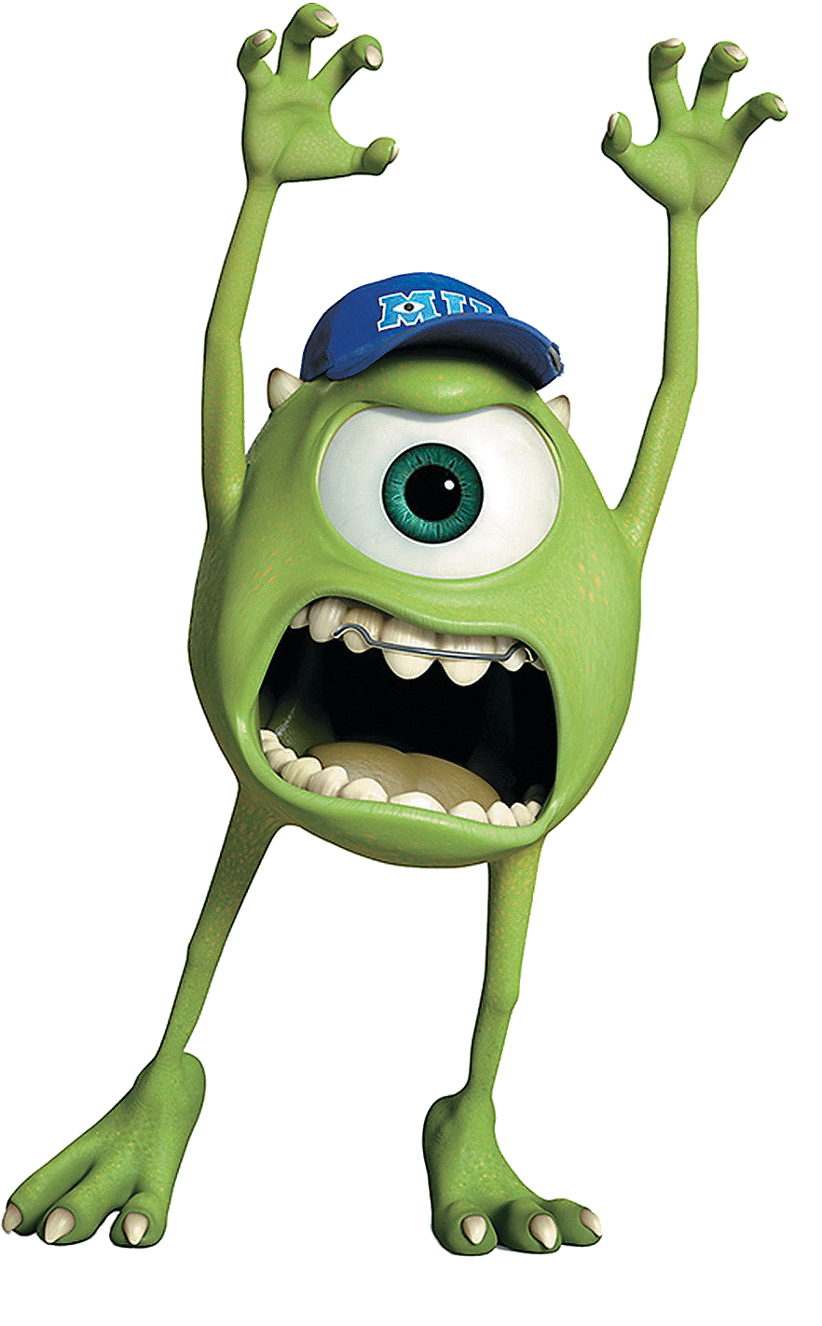
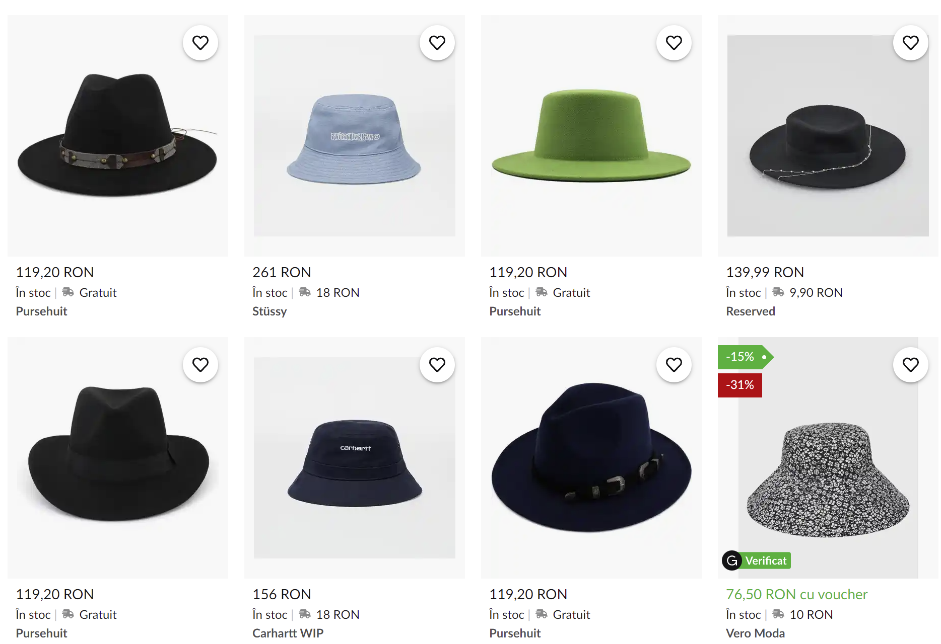
Step 6. Our guy is now prepared to be scary on Hallooween, with his new hat!
Buddy’s job, now, is to interpret the HTML code sent by the Web Servers and display the web page that the user requested..

